Slide 1
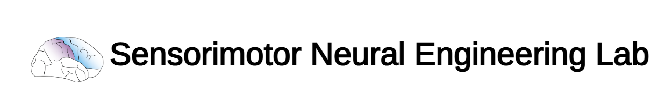
Phil, Zeyad, Tom Update
3/17/25

Slide 2
Contents
Overall System Architecture - Phil
Applicator - Zeyad
Performance of Strain Sensors - Tom

Slide 3
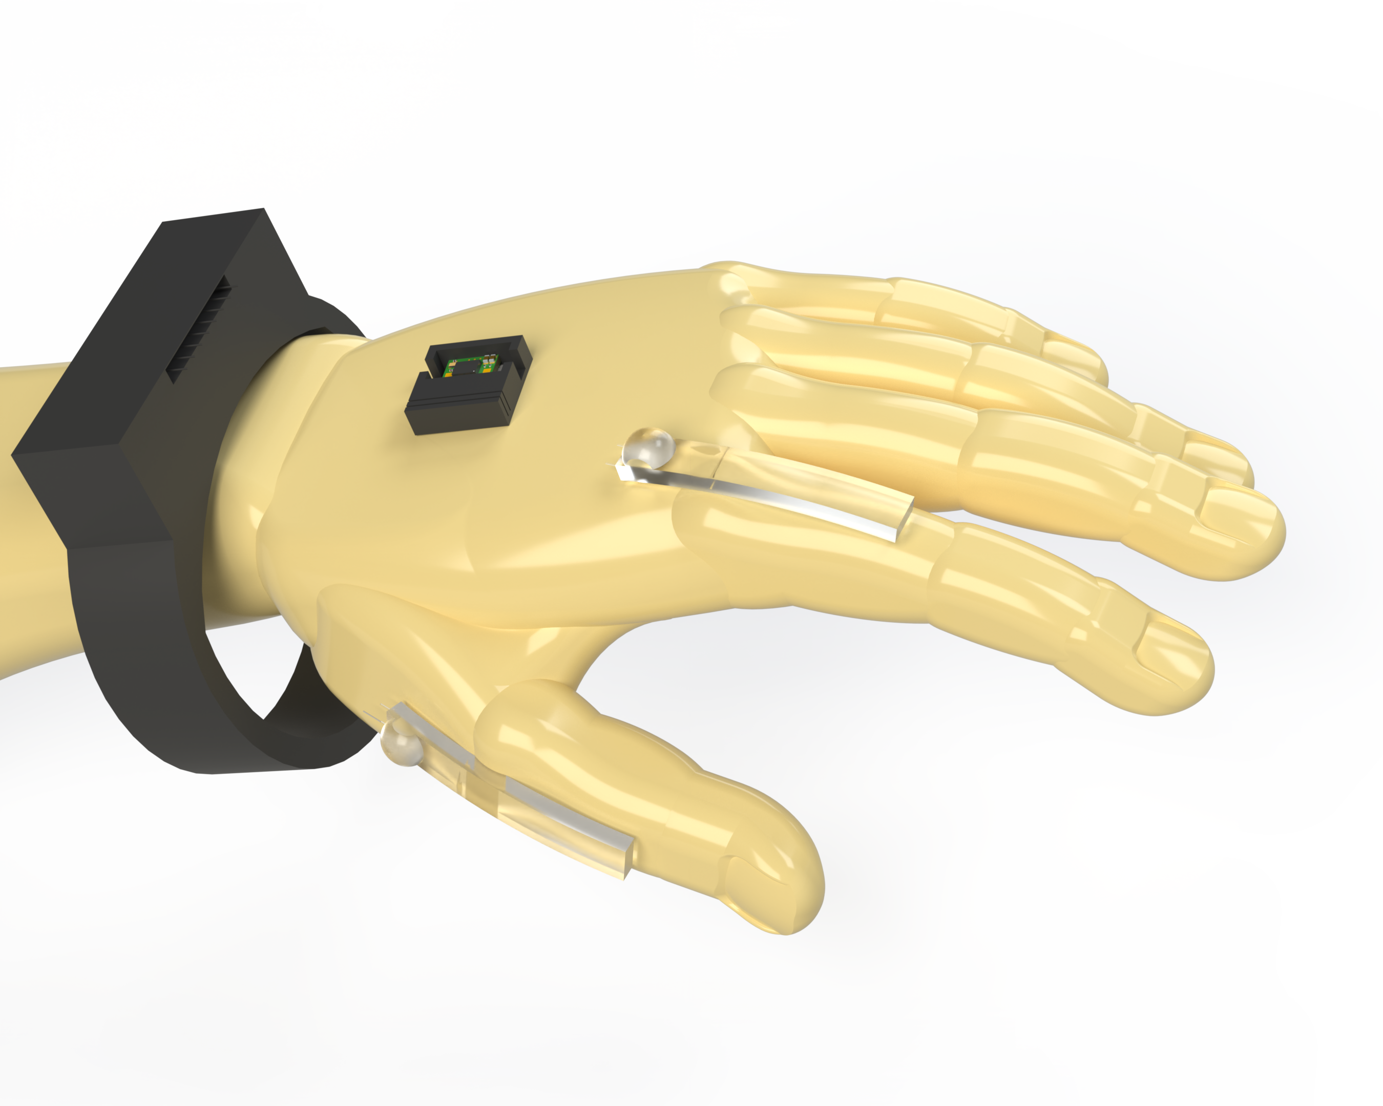
System Architecture

Slide 4
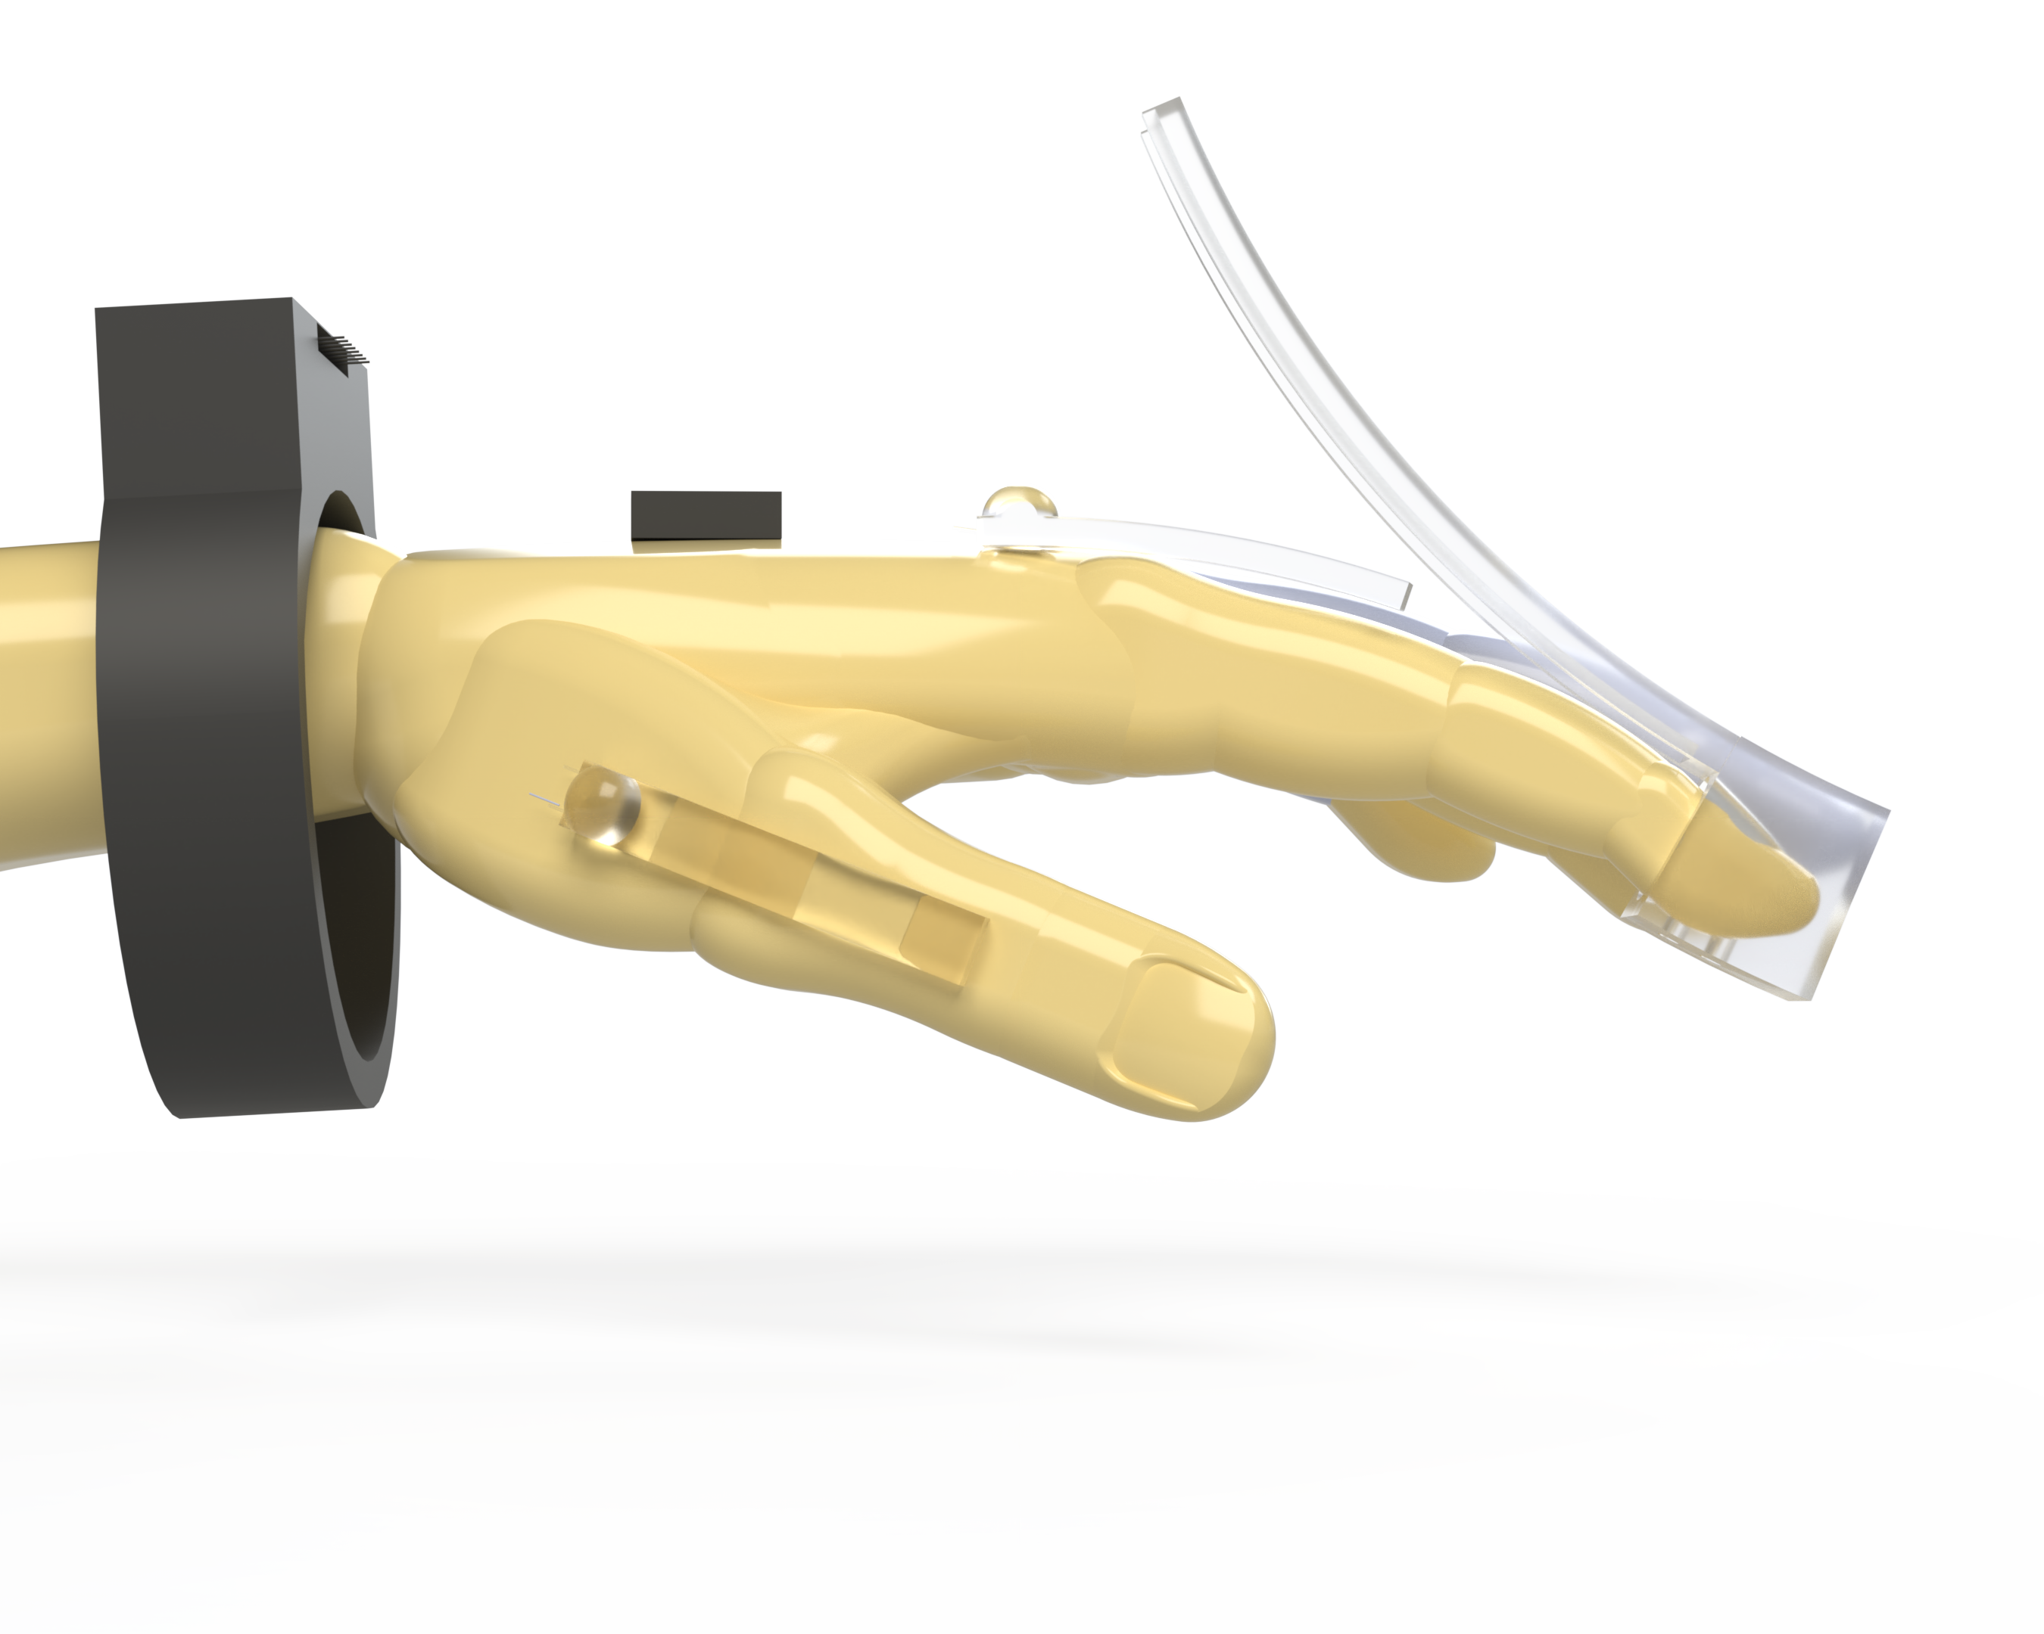
Strain Sensors with Applicator

Slide 5
Strain Sensors

Slide 6
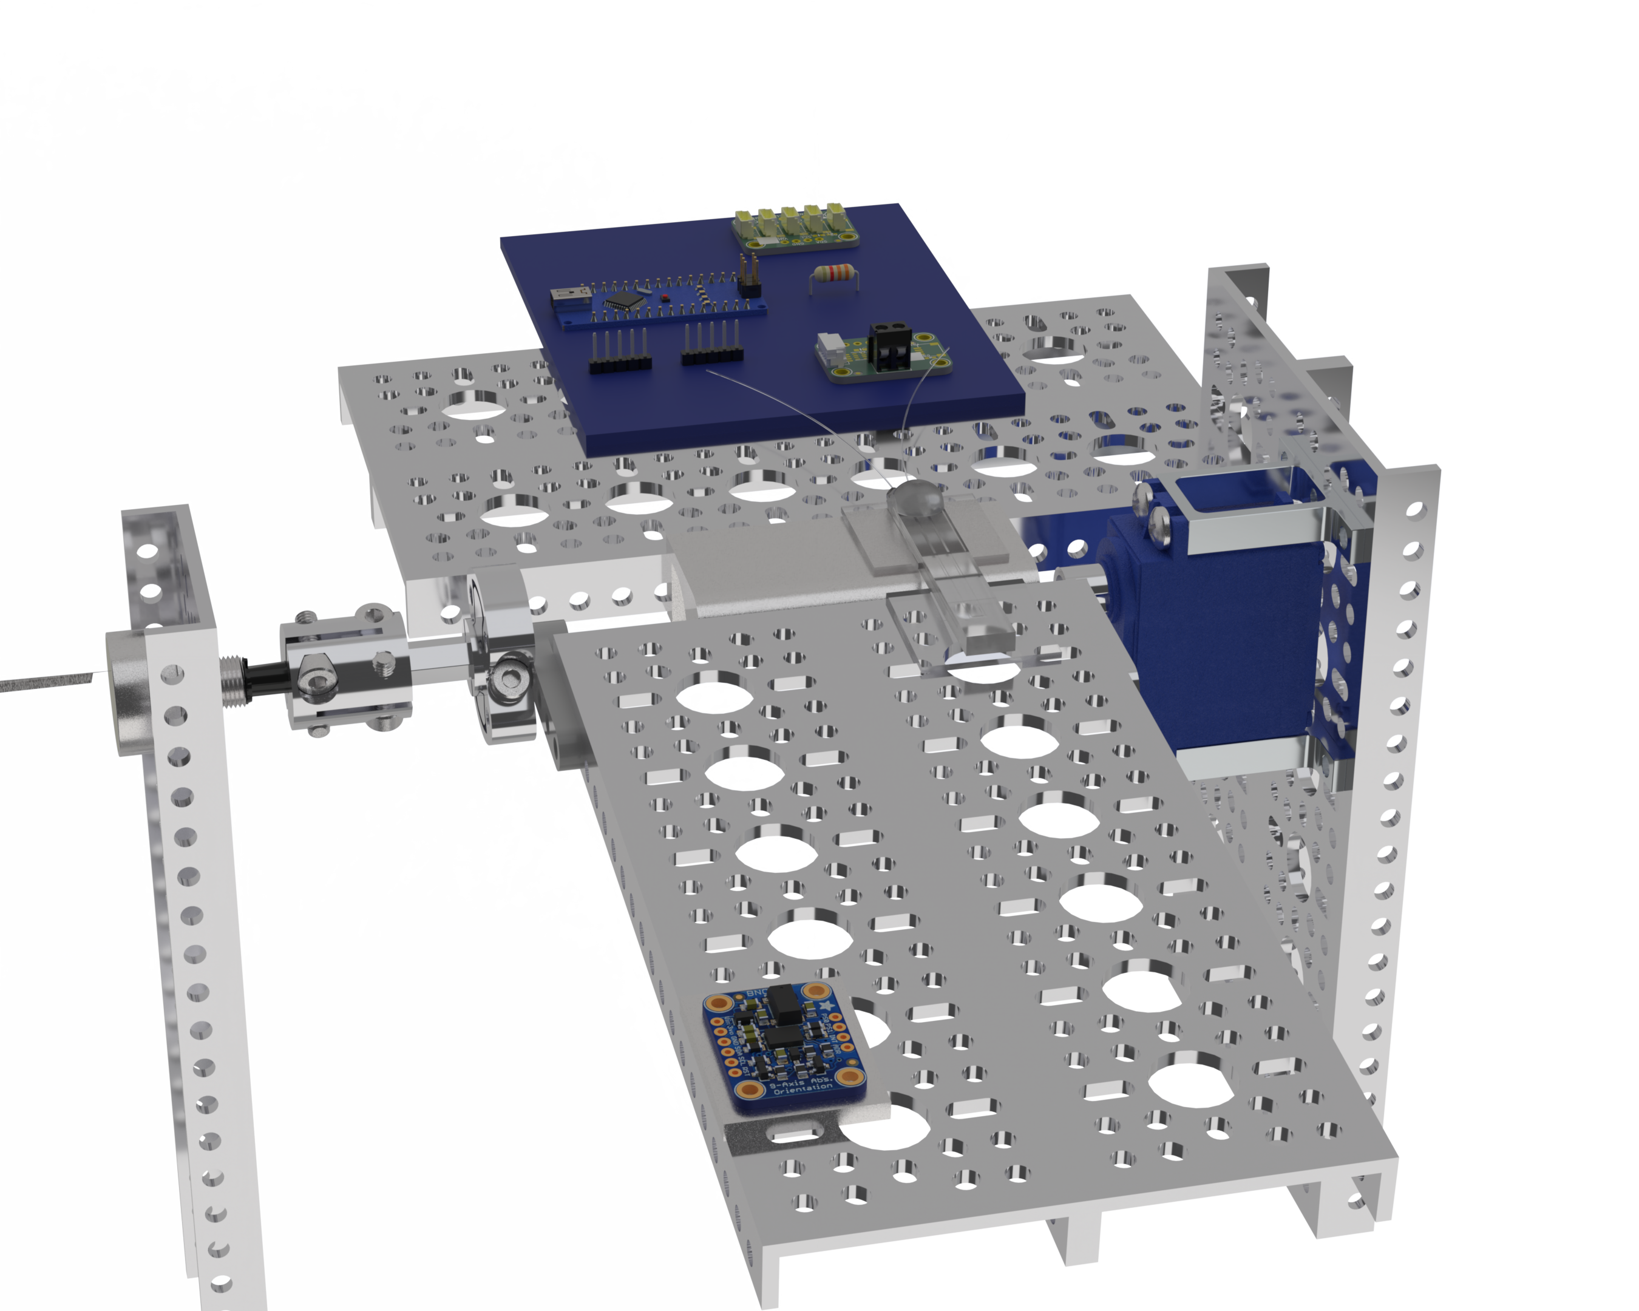
Auto Bender “Controlled” Testing

Slide 7
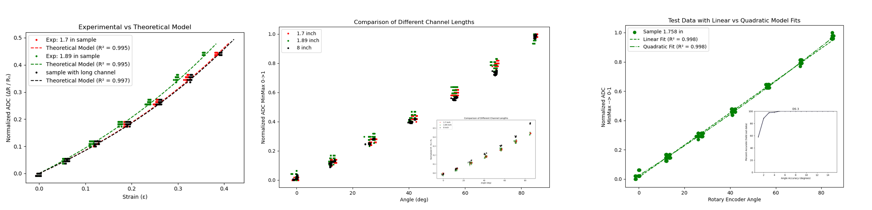
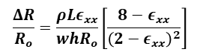
Theoretical Modeling and Curve Fitting
$$\frac{ΔR}{R_{o}}=\frac{ρLε_{xx}}{whR_{o}}\left[\frac{8−ε_{xx}}{{\left(2−ε_{xx}\right)}^{2}}\right]$$

Slide 8
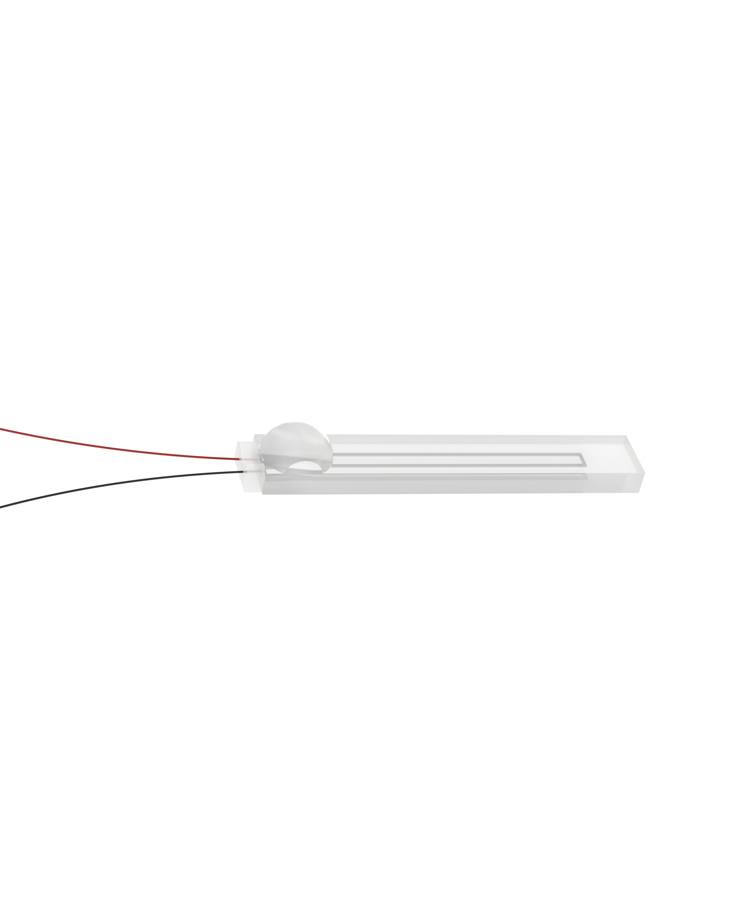
Auto Bender Varying Geometry

Slide 9
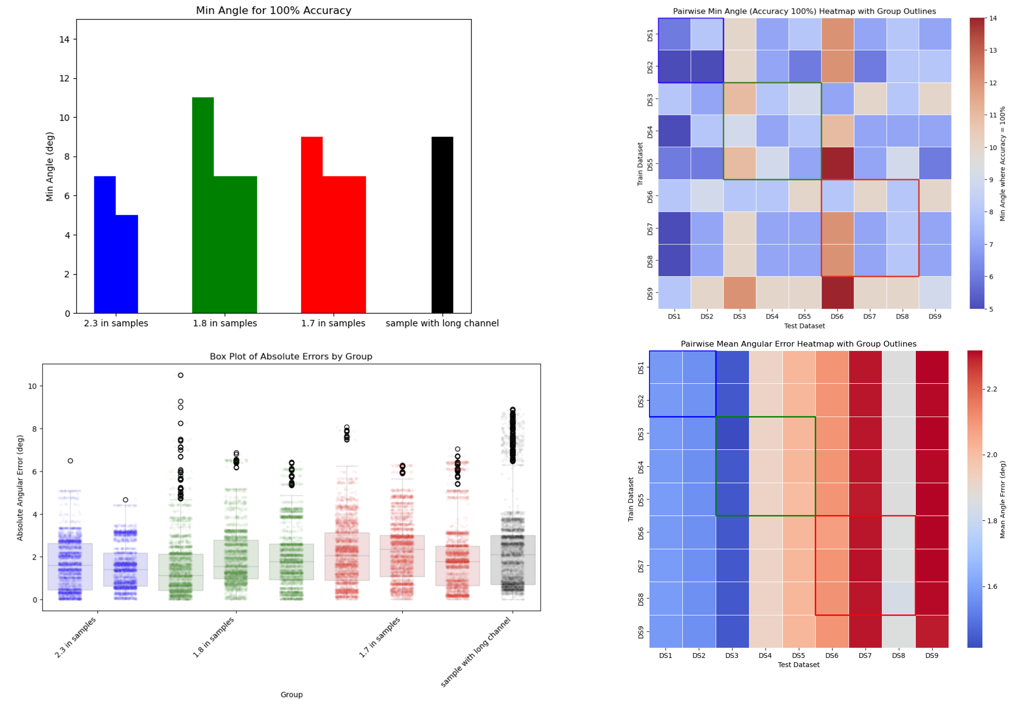
Auto Bender Varying Geometry
3 samples
4 samples
1 sample
2 samples

Slide 10
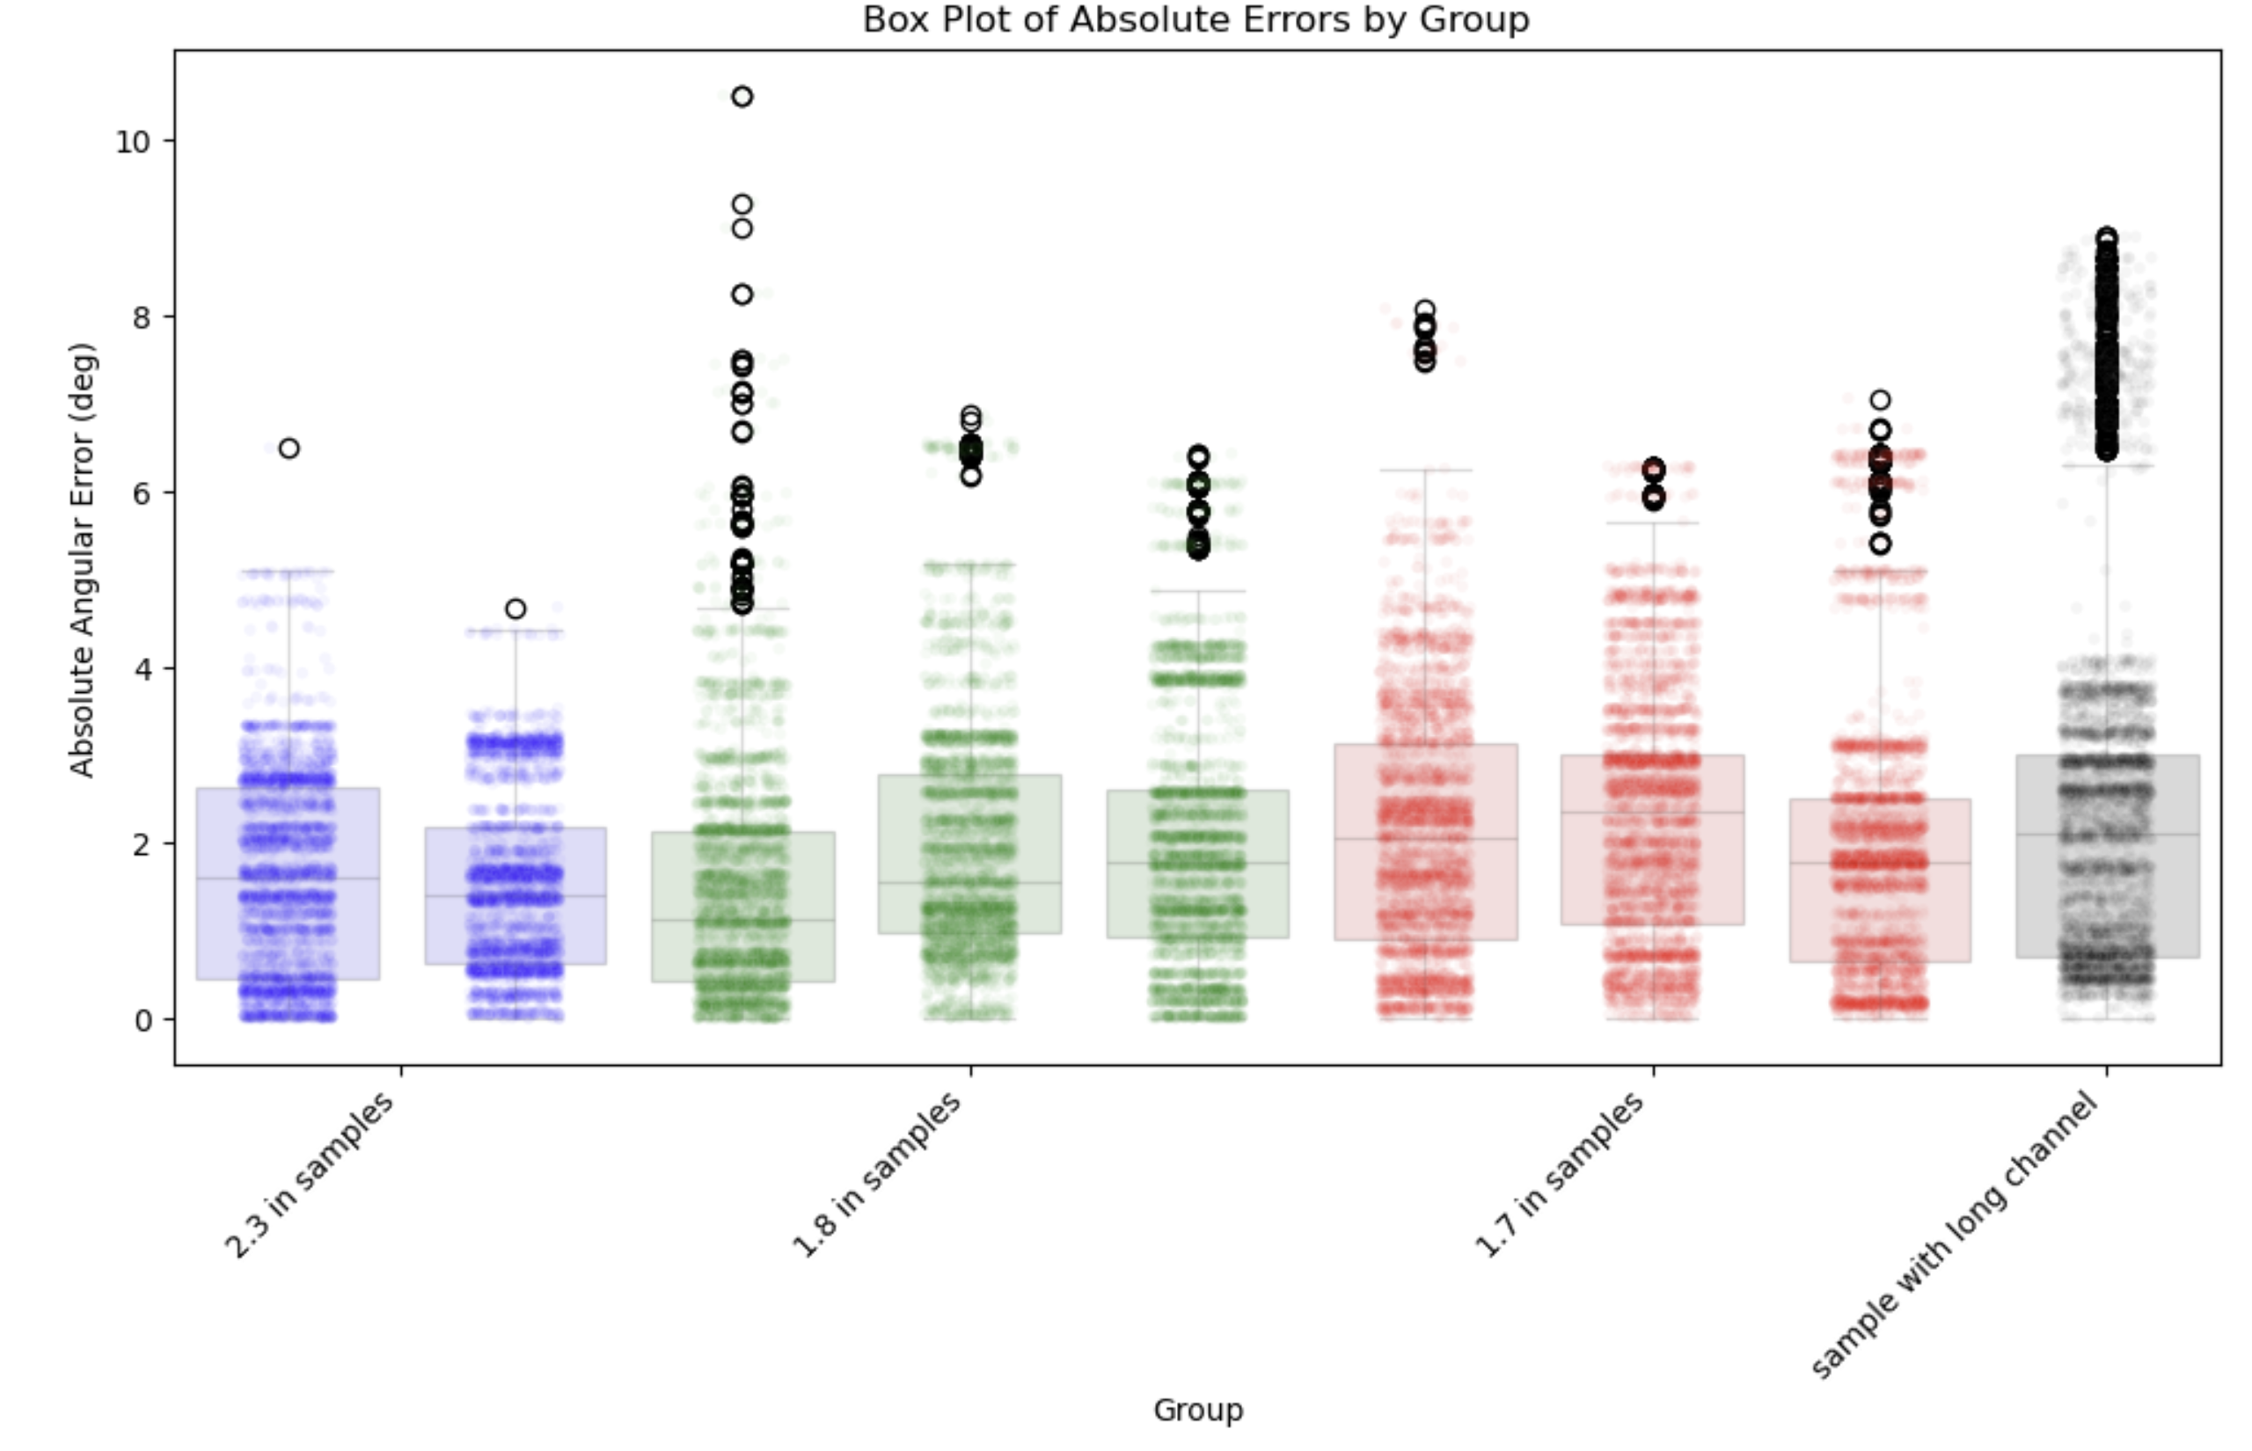
a. Performs 10-fold cross-validation by splitting 1 sample worth of data into 10 parts
b. Each fold uses 9/10 of the data for training and 1/10 for testing
c. Predicts angles for held out data points
d. Computes angular error abs(y_predict – y_test) across all folds
Q3+1.5×IQR
75% Percentile
Median
25% Percentile
Q1-1.5×IQR

Slide 11
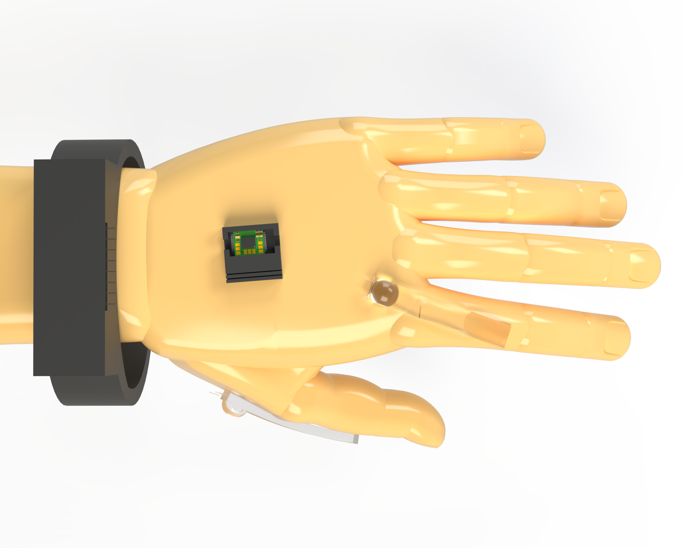
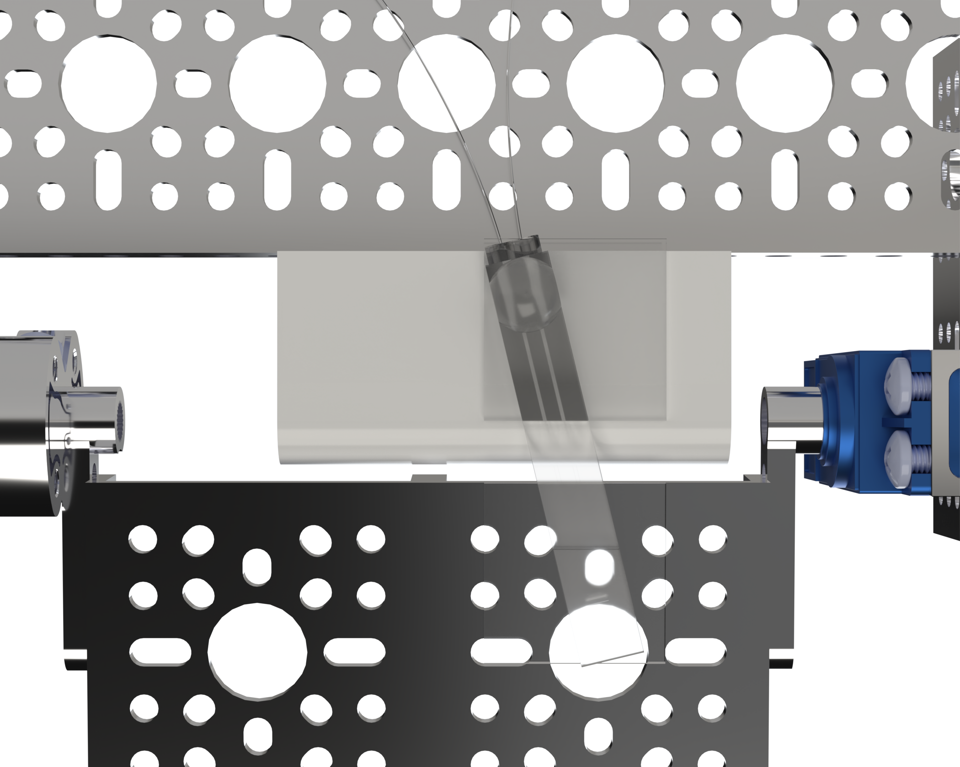
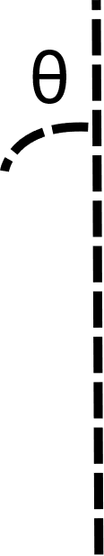
Auto Bender Misalignment Testing

Slide 12
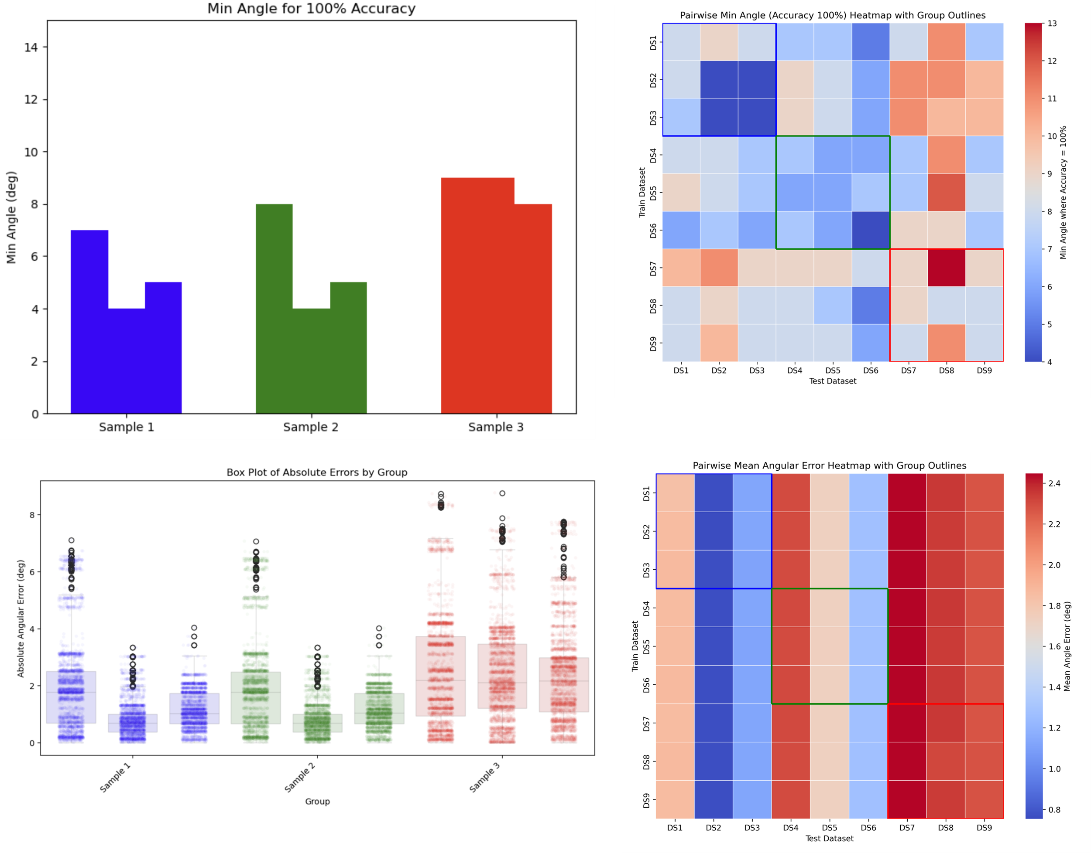
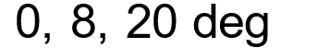
Auto Bender Misalignment Testing

Slide 13
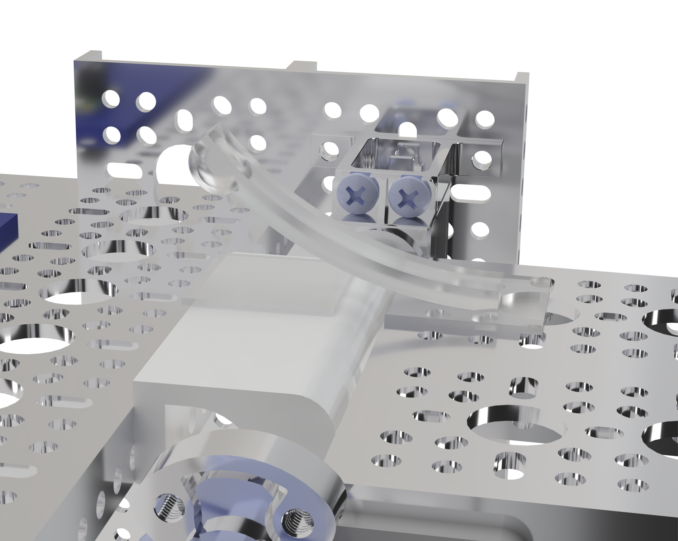
Auto Bender Reapplication Testing
Reapplication 4x per sample

Slide 14
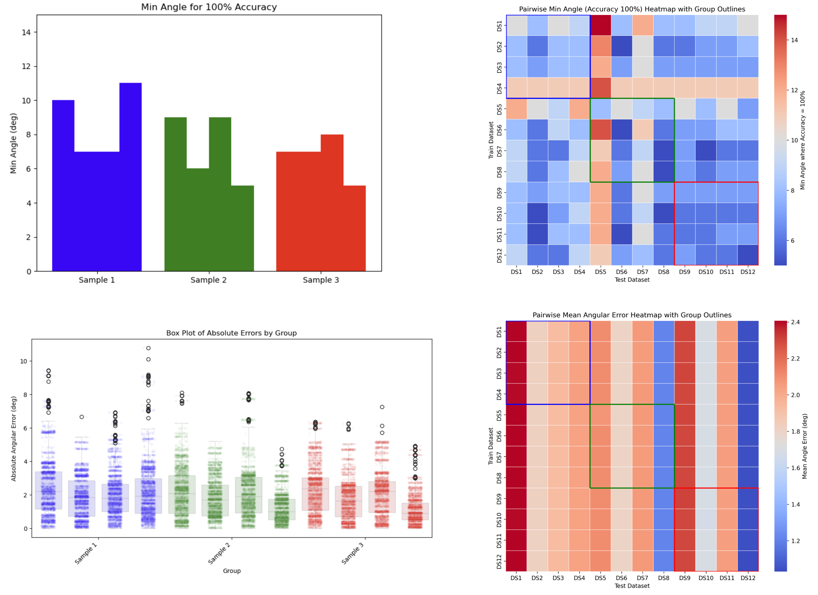
Auto Bender Reapplication Testing

Slide 15
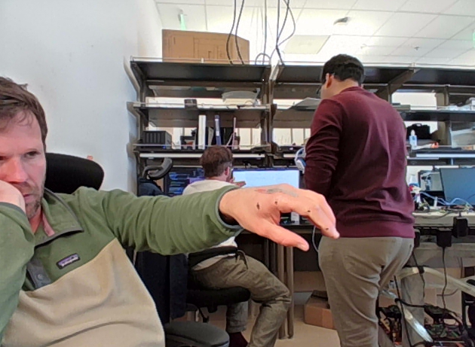
Next Steps: Redo Tests on Hand
DeepLabCut
~ 300 Frames
Extract Bend Angles per Frame
Compare bend angles to calibrated strain sensor

Slide 16
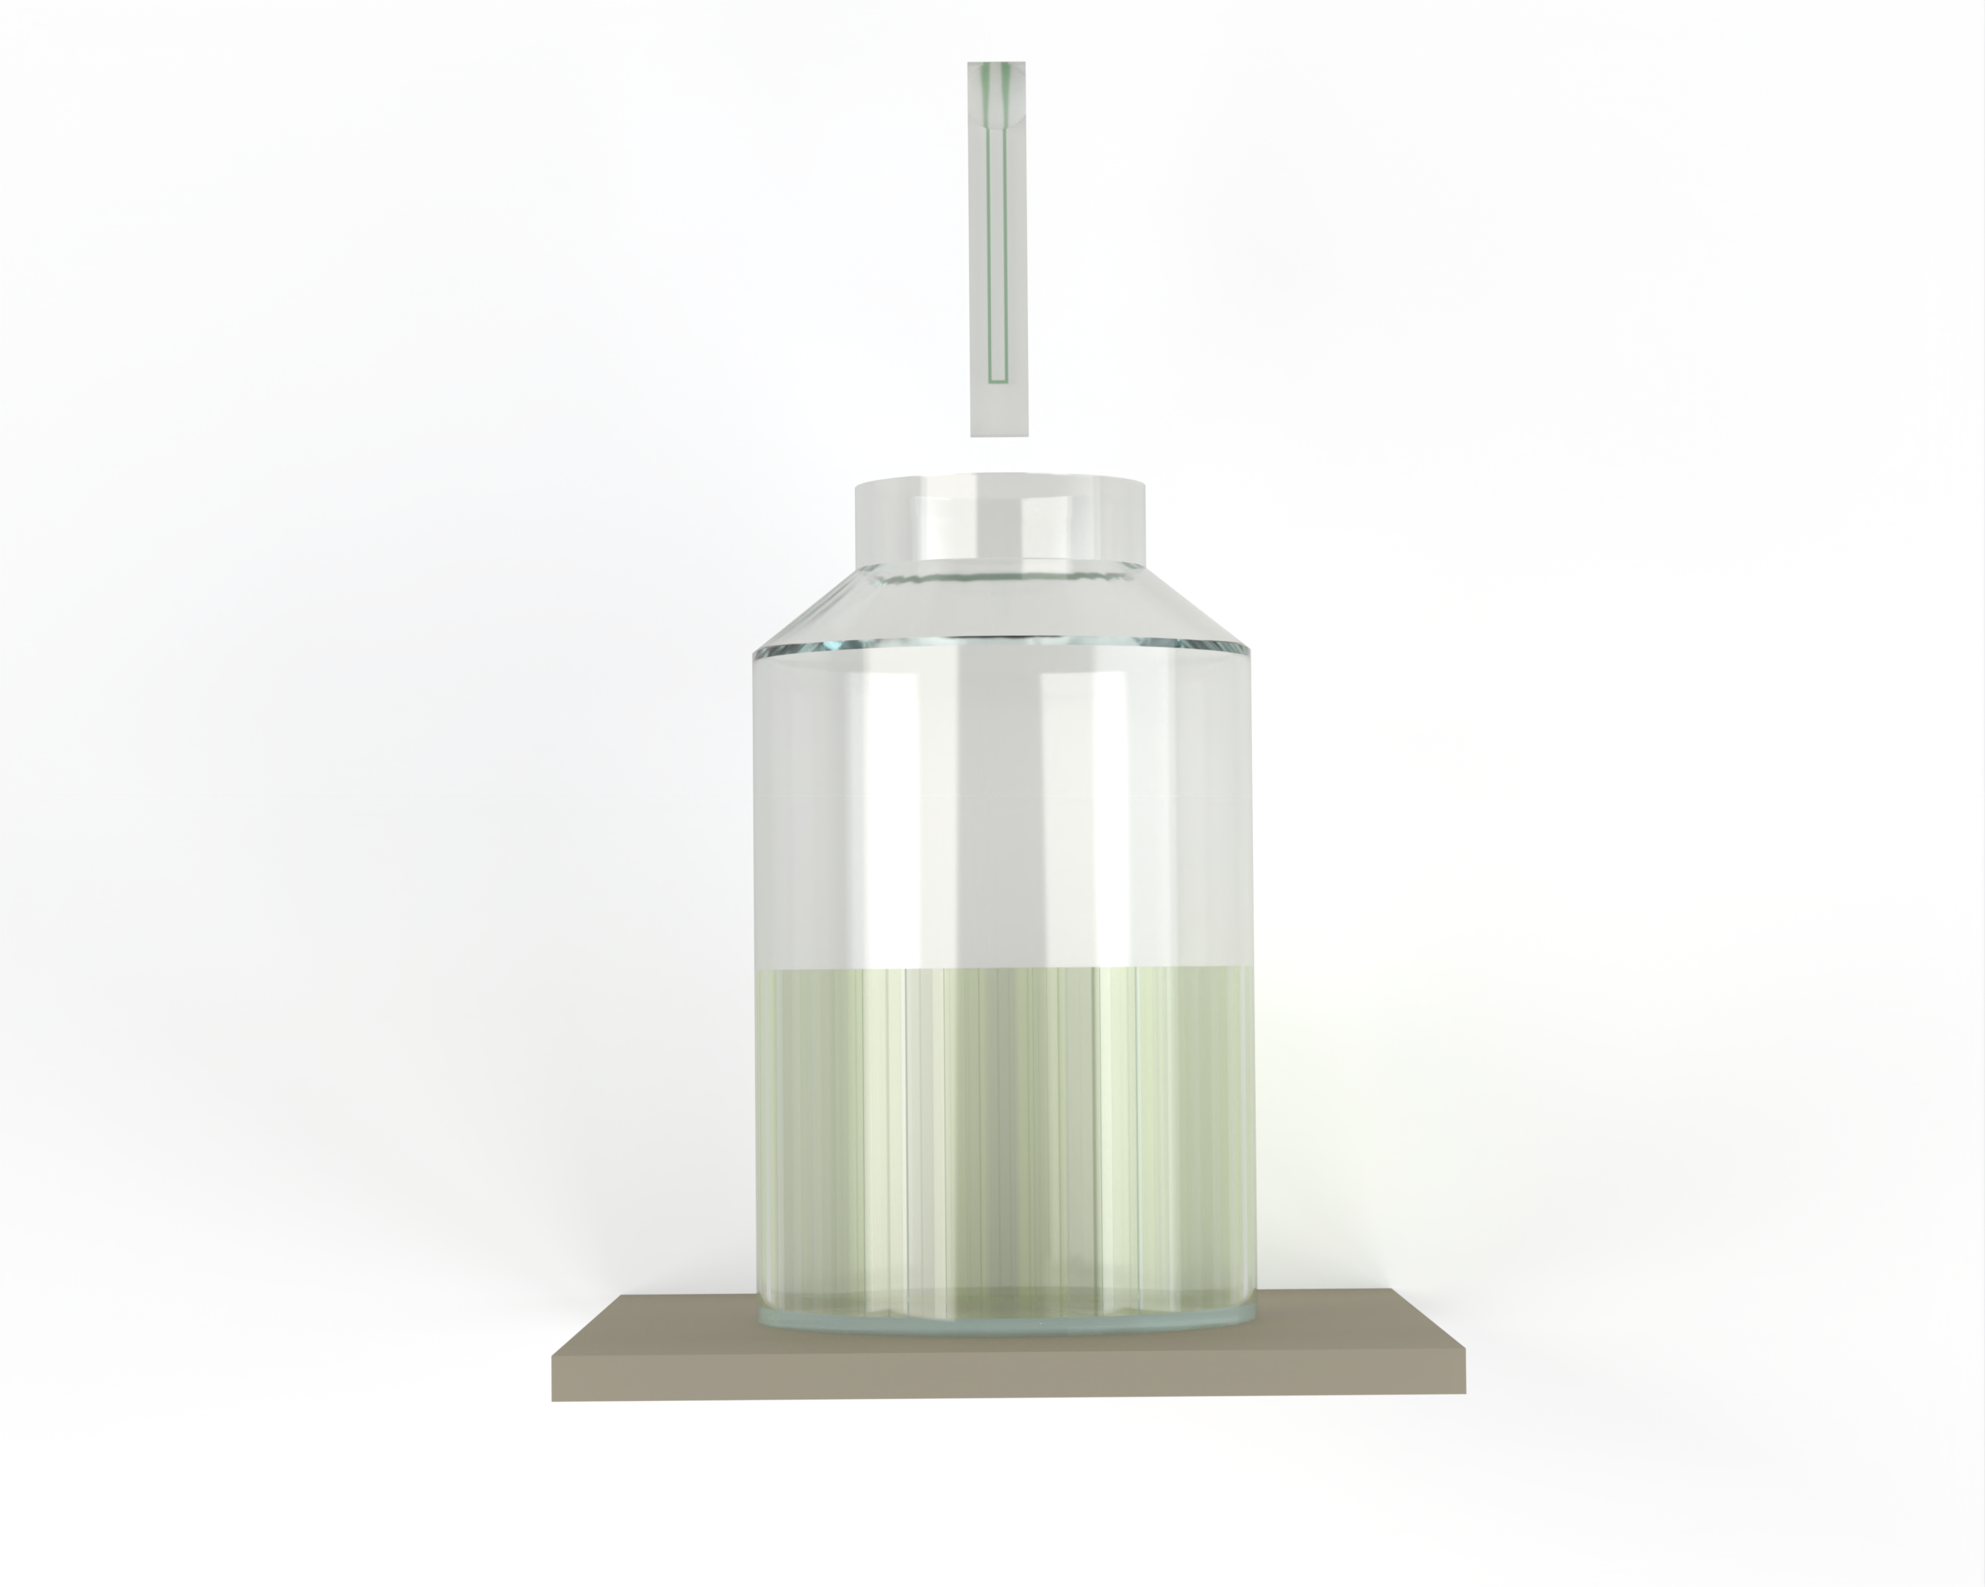
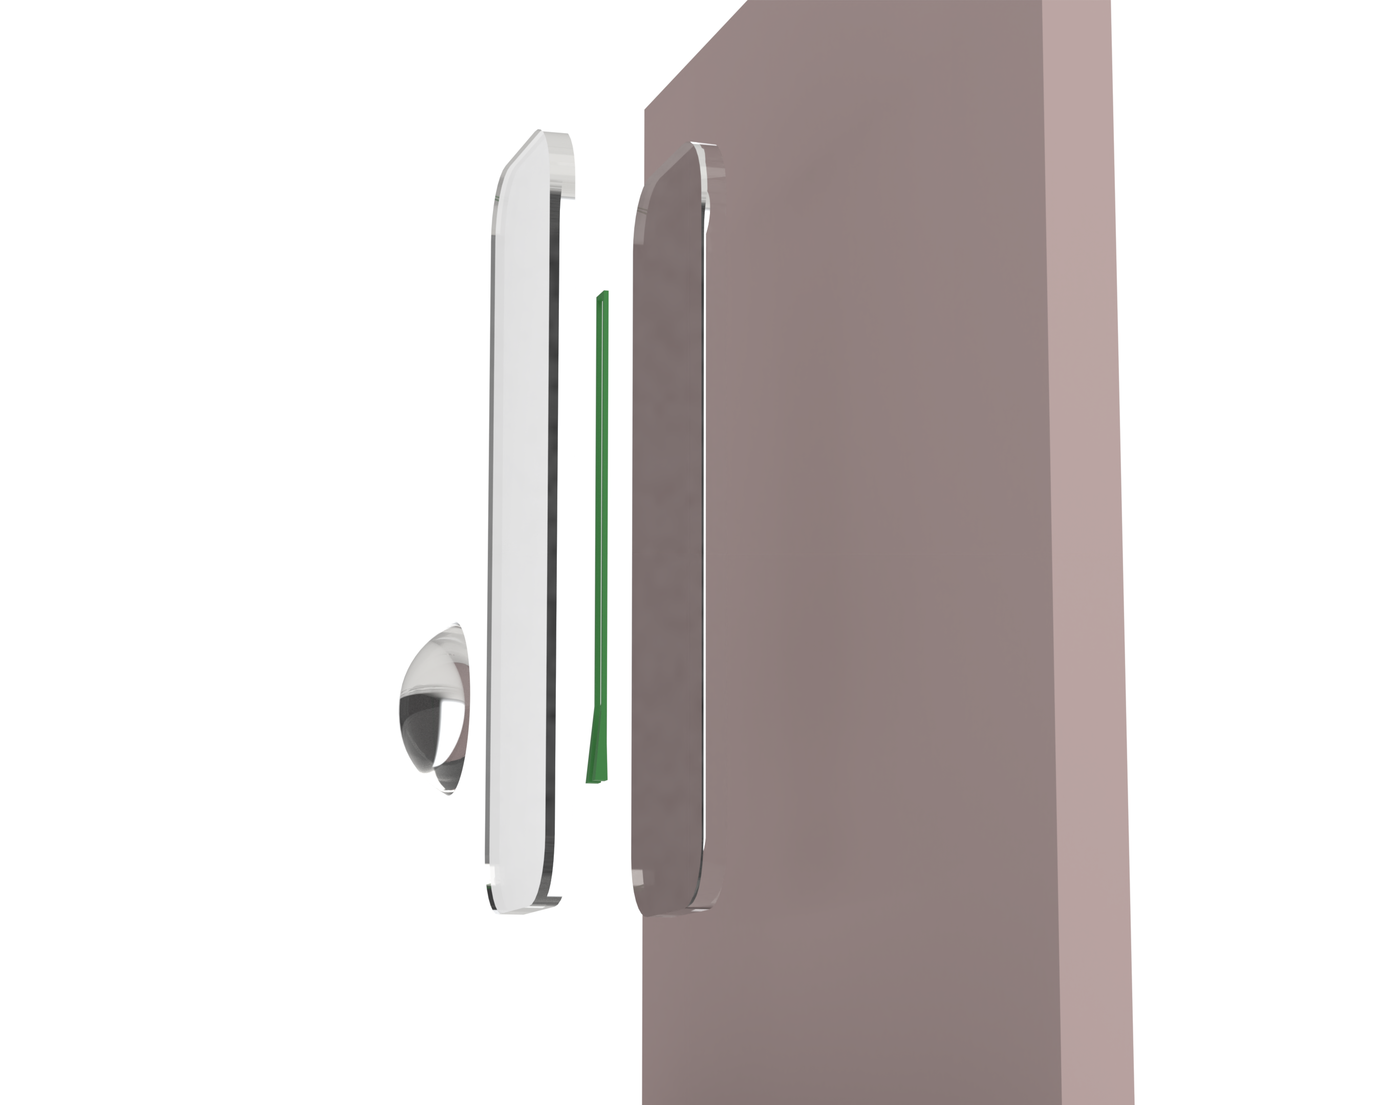
Fabrication Process

